Slide 1
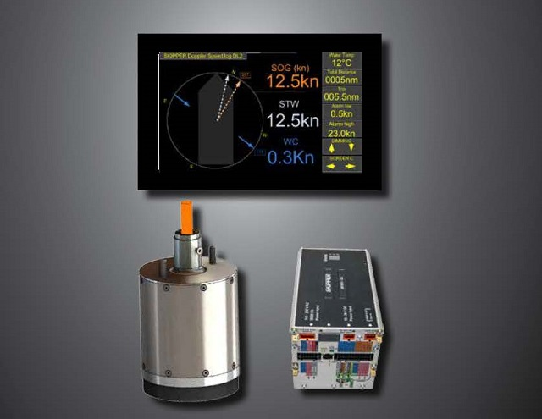
Advanced Calibration of the DL2 and DL21 system Part 1
Notes:
Purpose with this slide: Multi introduction
To describe the topics to be spoken about
Things to stress:
Linked to exam question:
Background information:
References :

Slide 2
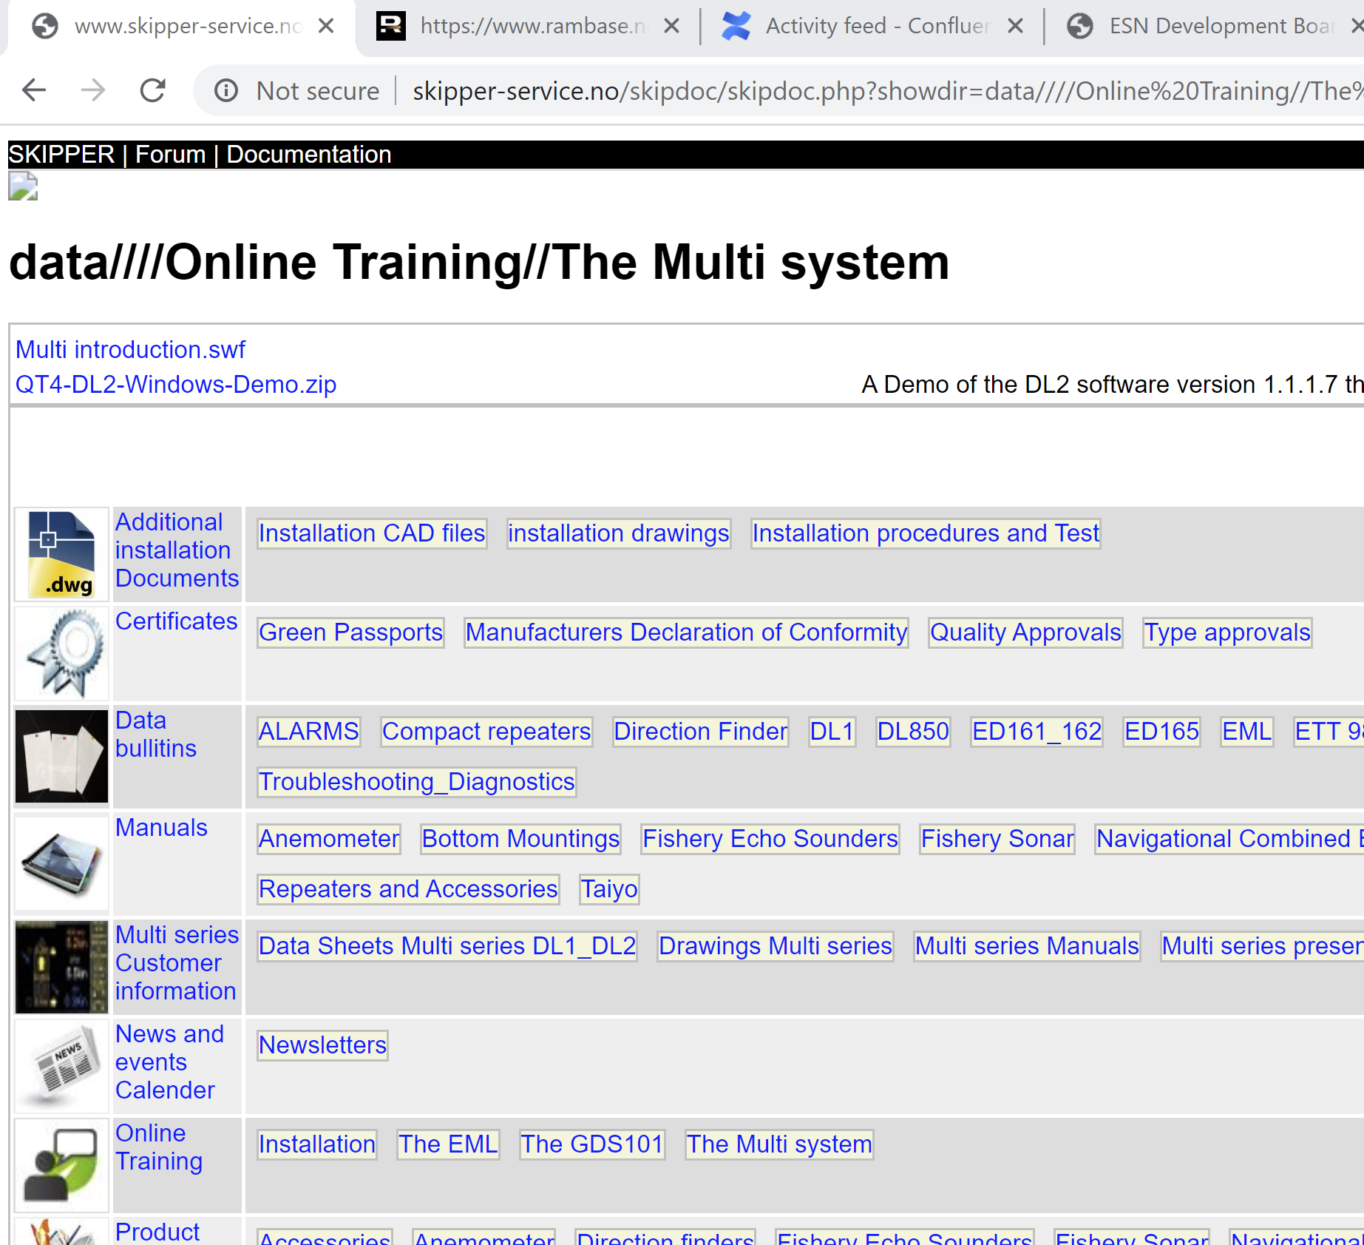
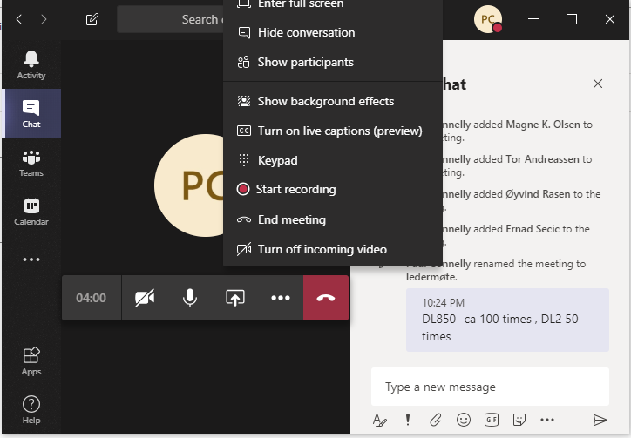
Calibration
Intro and the Basics
Welcome to a course about calibrating
Start by Downloading the Demo Software to your computer
www.skipper.no
Downloads
Online training
The Multi system
QT4-DL2-Windows-Demo.zip
http://www.skipper-service.no/skipdoc/data////Online%20Training//The%20Multi%20system/QT4-DL2-Windows-Demo.zip
Unpack the zip
In the folder DL2-PC Demo, start the file:
SW-M005-1.1.1.8-Windows.exe
In this folder you will also find the manual for this software, and post processing software Graphlog.exe
During the course, ask questions in the ‘show conversation’ chat area, SKIPPER service team will answer.
Please start by writing down how many times you have calibrated a skipper DL850 or DL2, so i know how experienced you are ….
Notes:
Purpose with this slide: Get the tools downloaded so you can follow along, and try out.
Things to stress:
Where are people from, what experience do they have.
Calibration on the Doppler logs is like an onion, you only see the outside, but inside there are many layers, you don’t need to see them to use the system, but the more you understand, the better you can ‘tune the system’
We are going to look at a number of these layers, and look at what you need to know, and what is nice to know, and a few things which are just information to explain why we have implemented in the way we have
Speed log expectations has changed in recent years, before it was just another piece of equipment often giving maintenance periods
Now it is used actively for navigation (Manouvring) and as the baseline for efficiency calculating
Simple setup Calibration brings the system within 2% as IMO specified
Fine tuning of the calibration brings it to within 1%
Linked to exam question:
Background information:
References :

Slide 3
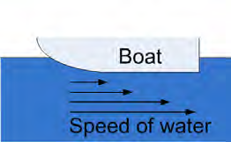
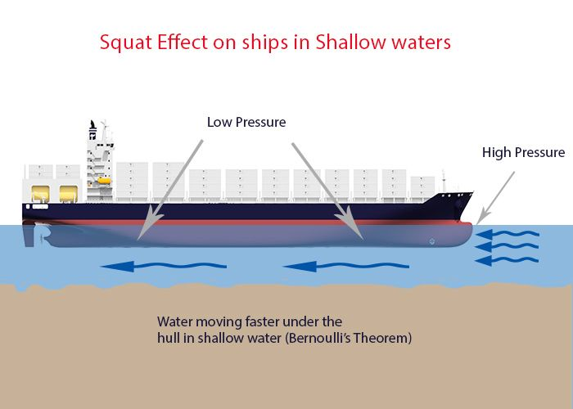
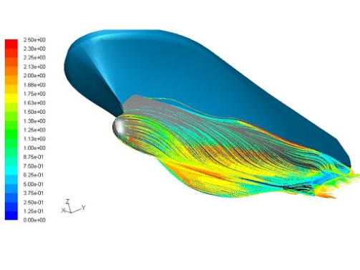
Calibration
Intro and the Basics
Introduction
What factors of a speed log change between vessels /systems?
The flow of water around the sensor
The mounting position, Depth of the sensor
Mounting angle and rotation of the sensor
The Growth on the hull
Notes:
Purpose with this slide: Diagnostics menu
What factors influence the accuracy of a speed log? And how can we remove them.
The difficult part to measure is STW, SOG is much more stable
The most important factor is the flow of water around the sensor
Each hull is different, the position of the sensor can make a lot of difference
The angle of the sensor
The flow of water is different near the hull and further away, where does the sensor measure, this changes over time with the growth on the hull
The EML measures very close, The Doppler can measure very close at high frequencies or further out with lower frequencies
Things to stress:
Angle of sensor
Angle of the water flowing past
The stability of the water flowing past
Growth
Squat effect is an interesting example where shallow water causes a suction (low pressure) under the vessel this can lead to
Jet streams of water, moving much faster.
Linked to exam question:
Background information:
References :

Slide 4
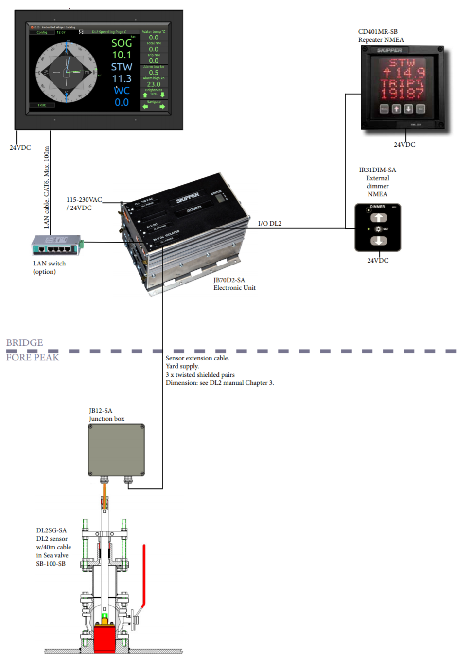
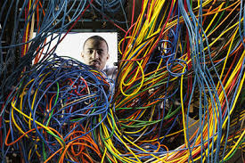
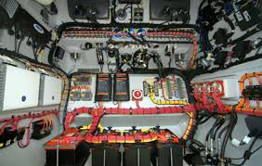
Calibration
Intro and the Basics
Introduction
What factors of a speed log change between vessels /systems?
The flow of water around the sensor
The mounting position, Depth of the sensor
Mounting angle and rotation of the sensor
The Growth on the hull
The Electrical mounting
cabling, electrical noise, grounding
Notes:
Purpose with this slide: Diagnostics menu
The Electrical mounting
Bad and good cabling ( cable thickness, shielding, running through noisy areas), stable power supplies, grounding
All these factors can cause noise on the very sensitive receivers, tuned to measure in the region of nano Volts
(Particles in water do not give a big echo)
Things to stress:
Linked to exam question:
Background information:
References :

Slide 5
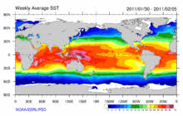
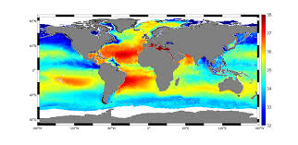
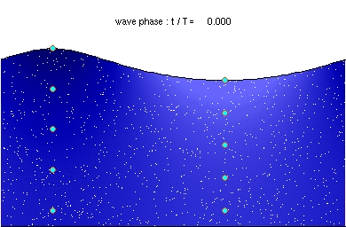
Calibration
Intro and the Basics
Introduction
What factors of a speed log change between vessels /systems?
The flow of water around the sensor
The mounting position, Depth of the sensor
Mounting angle and rotation of the sensor
The Growth on the hull
The Electrical mounting
cabling, electrical noise, grounding
The water
Temperature,
water salinity (salt content)
Particles in the water
Notes:
Purpose with this slide: Diagnostics menu
The Water itself has an effect
- temperature changes the noise in system, and in doppler , there is a 30 degree angle that changes with temperature and salinity, (mainly temperature)
The DL has a model to calculate the change of angle with temperature
Calibration sets the offset for this angle (offset is shown as an error in speed)
Particals in the water, give stronger signals (echos) and lift the doppler signal out of the noise, giving more accurate speeds
- The number of particals is often tied to the other factors, ans most particals are organic, therefore more in warm water
Things to stress:
Linked to exam question:
Background information:
References :

Slide 6
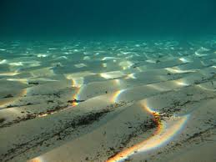
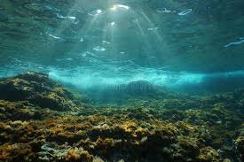
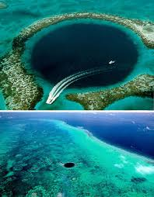
Calibration
Intro and the Basics
Introduction
What factors of a speed log change between vessels /systems?
The flow of water around the sensor
The mounting position, Depth of the sensor
Mounting angle and rotation of the sensor
The Growth on the hull
The Electrical mounting
cabling, electrical noise, grounding
The water
temperature,
water salinity (salt content)
Particles in the water
The Sea Bed
What its made of, and how it reflects sound
The angle of the sea bed
Notes:
Purpose with this slide: Diagnostics menu
The Sea bed The bottom type gives bigger or smaller reflections (SOG)
Mud absorbs sound, giving weaker signals
Rock gives strong reflections
The bottom can also influence the amount of life (Particals) in the water
Depth is also a factor, particularly with the squat effect.
Things to stress:
Linked to exam question:
Background information:
References :

Slide 7
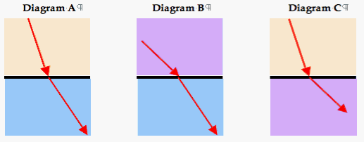
Calibration
Intro and the Basics
Introduction
What factors of a speed log change between vessels /systems?
The flow of water around the sensor
The mounting position, Depth of the sensor
Mounting angle and rotation of the sensor
The Growth on the hull
The Electrical mounting
cabling, electrical noise, grounding
The water
temperature,
water salinity (salt content)
Particles in the water
The Sea Bed
What its made of, and how it reflects sound
The angle of the sea bed
The sensor
Small diferences in the resonances, of the ceramic and transformers in the system
The noise level of the system and the power output
The Acoustics
With temperature and salinity, the sound bends as it passes through the sensor and water
Notes:
Purpose with this slide: Diagnostics menu
Acoustics of the system,
Temperature and salinity influence the physical effects of the system, which works on the accuracy
Particals in the water change the signal echoes
Weather and waves effect the acoustic noise
Depth and bottom echo strength , can cause interference
Other systems on the vessel, maybe mounted too close, can cause interference
Things to stress:
Linked to exam question:
Background information:
References :

Slide 8
Calibration
Intro and the Basics
Introduction
What we need to calibrate on a Doppler Speed log?
Temperature offset
Temperature should be correct (bending model of the sound coming from sensor to water)
Speed over ground
To remove any offset of frequency within the system
Speed through water
To remove frequency offset and effects of water flow
Heading error
To remove mounting errors
Notes:
Purpose with this slide:
Which factors does the installer or crew need to adjust or calibrate?
Temperature offset – The system includes a model of how the sound bending changes as it comes out of the system, if there is an offset, this should be set first
If set afterwards, the speed calibration may get a small offset
Speeds (SOG STW) the offsets and angular errors can be calibrated away
Also the flow of water around the sensors sampling area , can be calibrated, this tends to change as the speed changes, and this can be calibrated away
The mounting error of the sensor in Azimuth (rotation)
The angle of the water flow around the sensor
Things to stress:
Linked to exam question:
Background information:
References :

Slide 9
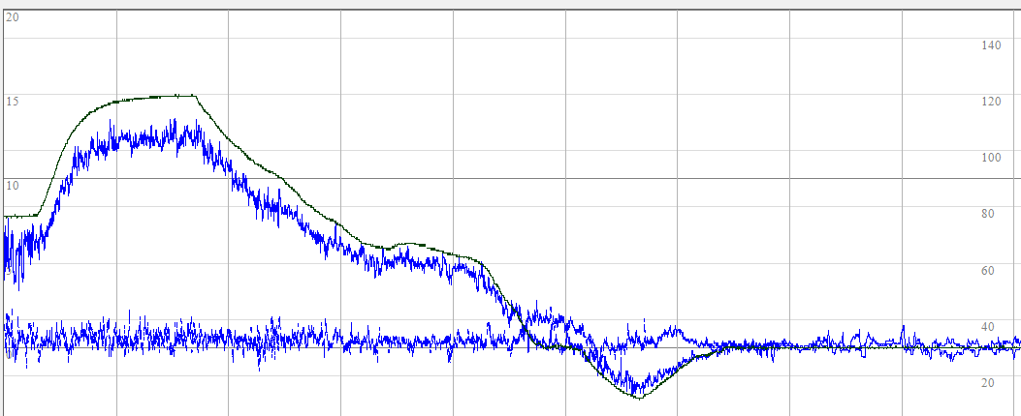
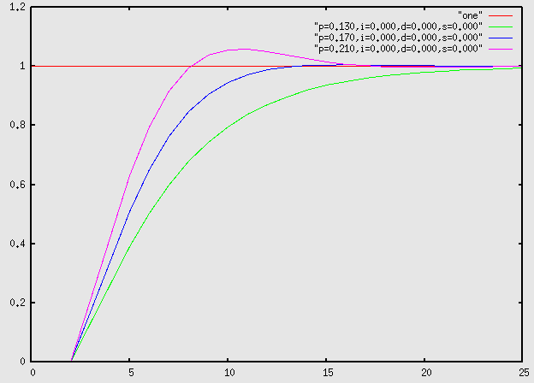
Calibration
Intro and the Basics
Introduction
What do need to calibrate on a Doppler Speed log?
In addition we should set a sensible averaging for the system
Too low – jumpy (unstable) speeds
Too High – The system is slow, particularly when manouvring
Notes:
Purpose with this slide: Diagnostics menu
Response time and accuracy of the system has become more in focus in recent years
Averaging and filter of the system
Ships have different modes of operation
Transit, the user wants a stable reading – longer averaging is fine,
Manouvring the user wants a quick response – shorter averaging is better.
This all depends on the size and tonnage of the vessel
The system will adjust the averaging a bit based on tonnage, but this can be tuned from 5 seconds to 100
Typical is about 10 seconds.
Critical users are often most interested that when they go from port to starboard with thrusters, the SOG crosses zero at the correct time.
Things to stress:
Linked to exam question:
Background information:
References :

Slide 10
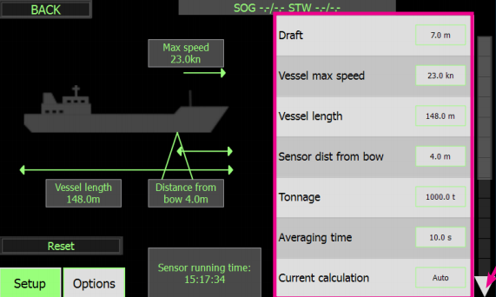
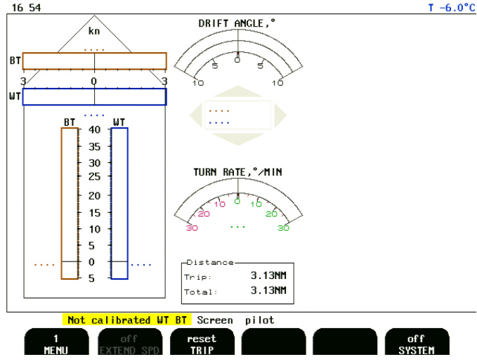
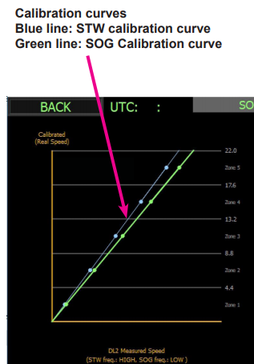
Calibration
Intro and the Basics
The Process
The DL850
Speed range – not used much
The DL2
Speed range
DL2 installation Manual
Page 30
Notes:
Purpose with this slide: Diagnostics menu
Set up max speed
DL850 normally 30kn, but could be extended to 40
DL2 set max, to speread out the calibration points and help internal filter (+-50kn opens for noise issues)
Things to stress:
Linked to exam question:
Background information:
References :

Slide 11
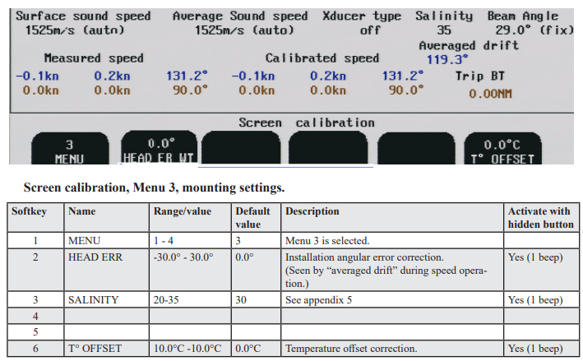
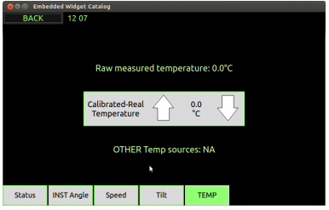
Calibration
Intro and the Basics
The Process
The DL850
Speed Range
Temperature
The DL2
Speed range
Temperature
DL2 User Manual
Page 31
Notes:
Purpose with this slide: Diagnostics menu
Set the offset.
DL2 has 2 points, the user doesn’t see that.
Things to stress:
Linked to exam question:
Background information:
References :

Slide 12
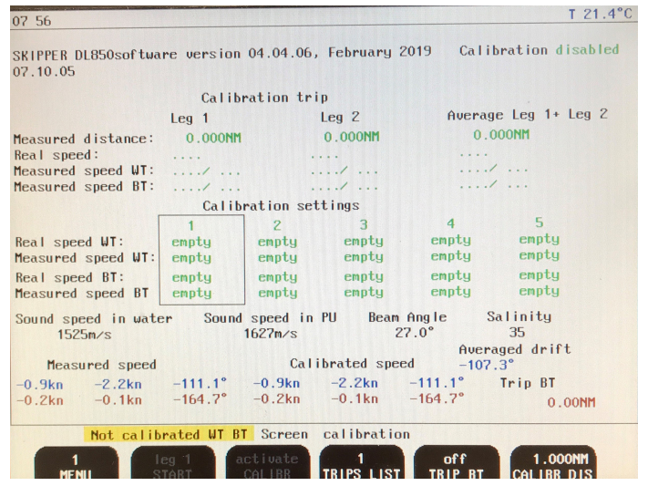
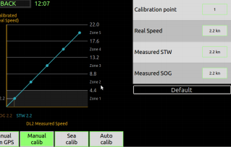
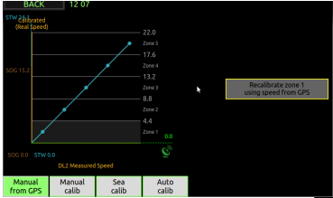
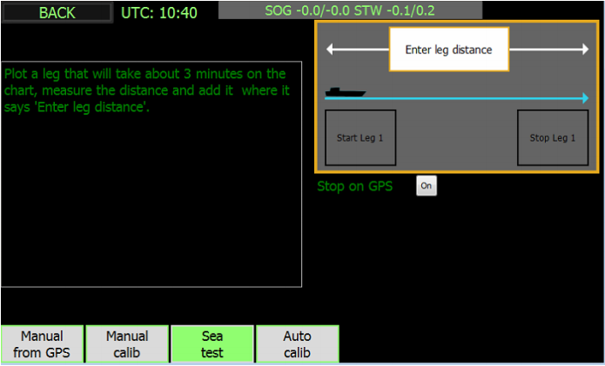
Calibration
Intro and the Basics
The Process
The DL850
Speed range
Temperature
Speed over ground
Speed through Water
The DL2
Speed range
Temperature
Speed over ground
Speed through water
DL2 User Manual
Page 27
Notes:
Purpose with this slide: Diagnostics menu
Speed – the important bit
Using one of three methods, manual , sea test, or GPS
Things to stress:
Linked to exam question:
Background information:
References :

Slide 13
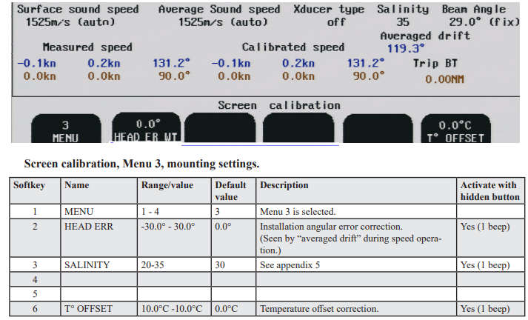
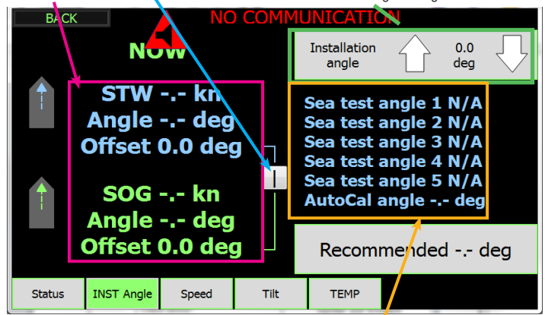
Calibration
Intro and the Basics
The Process
The DL850
Speed range
Temperature
Speed over ground
Speed through water
Heading
The DL2
Speed range
Temperature
Speed over ground
Speed through water
Heading x 2
DL2 User Manual
Page 26
Notes:
Purpose with this slide: Diagnostics menu
Heading offset and in DL2 Water offset
Explained later
Things to stress:
Linked to exam question:
Background information:
References :

Slide 14
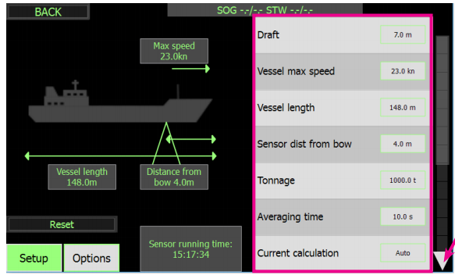
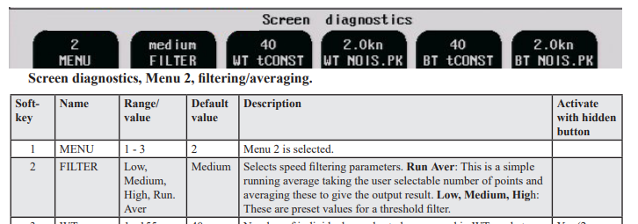
Calibration
Intro and the Basics
The Process
The DL850
Speed range
Temperature
Speed over ground
Speed through water
Heading
Averaging/Filters
The DL2
Speed range
Temperature
Speed over ground
Speed through water
Heading x 2
Averaging /Filters <6kn >6kn
DL2 Installation Manual
Page 30
Notes:
Purpose with this slide: Diagnostics menu
Averaging to make sure the response is quick enough for the type of vessel
Things to stress:
Linked to exam question:
Background information:
References :

Slide 15
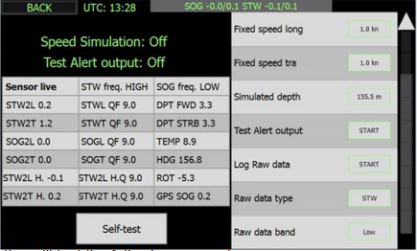
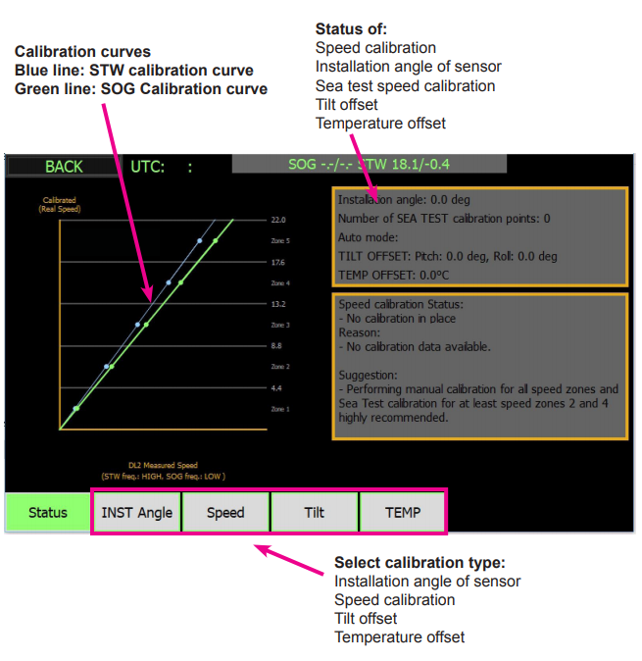
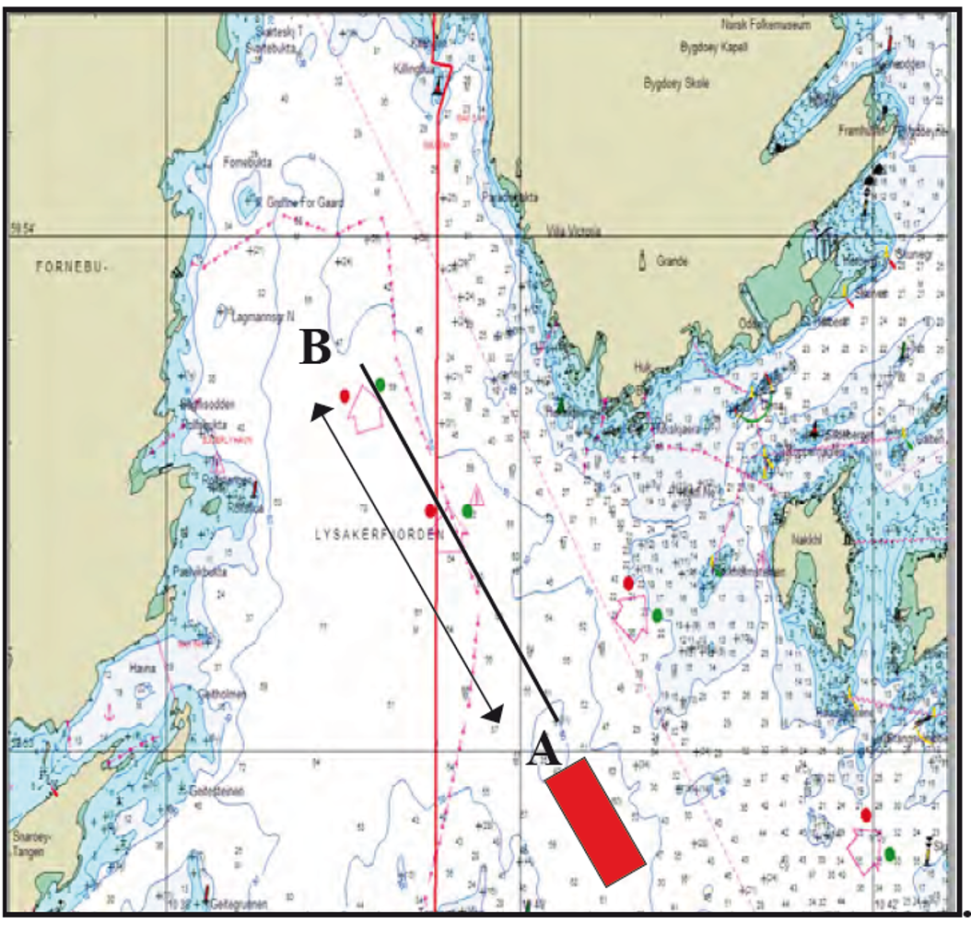
Quick Check before calibration
Calibration on DL2
The Process
Check you are in an area with depth less than the calibration (max 150m typ 100m) throughout the whole leg (legs)
Check the sensor signals are approximately correct and stable
(DL850) Screen diagnostics
(DL2) Config -> Diagnostics ->Sensor Live
Check the speed you will use is not too close to a previously sea test speeds
Make sure you have set the max speed of the vessel in config ->DL2 setup (changing this deletes the calibration points)
Notes:
Purpose with this slide: Diagnostics menu
So what to do?
First check the system is working and stable
Use the Diagnostic pages
Check the area you are going to calibrate in is not too deep or too shallow (10-100m is ideal)
Check the calibration table , and only calibrate at good spacings, not 6kn 7kn 8kn , Spread them out over the speed range
Be aware that power 60-100% doesn’t always have a large speed difference.
Things to stress:
2 points next to eachother can cause more problem than good, that is why you can only have 1 point per speed zone (DL850 often had 5 calibrations at the same speed, and this caused problems)
Linked to exam question:
Background information:
References :

Slide 16
Calibration in the DL2
Calibration on DL2
Calibration of:
Temperature sensor
Speed
Installation angle
Tilt sensors
The Process
Notes:
Purpose with this slide:
calibration
Things to stress:
3 things to calibrate
1 Temperature – set the offset to make sure the bending angle of the acoustic beams in the sensor is approximately correct
2 Mounting error – check that ahead is ahead
3. Speed check the amount of drag under the vessel ( more on STW parameter)
Titl sensor are adjusted in factory, and only need adjusting for the screen dosplay
Linked to exam question:
Background information:
References :

Slide 17
Temperature offset
Calibration on DL2
The Temperature sensor may have some offset due to the mounting. This may be adjusted at a low temperature <12, and at a high temerature >15
Temperature is used to ensure the angle the beam is pointing is correct in the calculations (this varies with temperature)
The Process
Notes:
Purpose with this slide:
What is temperature used for
Things to stress:
The Sensor is made of polyurethane and this is made in a way to make the sensor tough but also acoustically matched to the water,
The sound is bent as it passes from the plastic to the water, and is initially send at 30 degrees.
This bending changes with the temperature difference between water and the sensor.
The temperature sensor allows the software to compensate for the bending at different water temperatures.
The system is calibrated at a temperature and when the vessel moves to warmer or colder water, this will effect the calibration, however the internal model within the system should compensate for this.
Offset adjustment is important before calibration
Linked to exam question:
Background information:
References :

Slide 18
Speed
Calibration on DL2
Speed calibration should be a 1 time task, but may need occasional recalibration, if the sensor moves, or the hull hasnt been cleaned and water flow changes.
The Process
Calibration involves sailing 2 opposite legs, at various speeds
The calibration can be tuned, manually or using a GPS input
DL2 User Manual
Page 27
Notes:
Purpose with this slide:
The principles of calibration
Things to stress:
Calibration requires at least 1 sailing of 2 legs on the same track. At high speed and maybe at a medium speed. In an area shallower than 150m
The DL2 software has 5 points that can be calibrated manually , by sea test, or self calculate from the other points.
Linked to exam question:
Background information:
References :

Slide 19
Speed Status Screen
The system has 5 calibration ‘zones’ each containing calibration points. It is usually good enough with 1 point at vessels max speed. On larger vessels we typically have one at 8kn and one at high speed
Calibration on DL2
The Process
Each zone can have just 1 active calibration point, but sves 3 points:
Default- (calculated by the system from the existing selected calibration points)
Sea- measured during a 2 leg sea test
Manual – manually adapted value, or taken from GPS
The user can select which of these 3 is to be used.
DL2 User Manual
Page 24
Notes:
Purpose with this slide:
Things to stress:
Each zone can have a manual or sea test. Both are stored and can be reselected. , also the default value ( calculated from the values around)
Linked to exam question:
Background information:
References :

Slide 20
Manual Calibration
Calibration on DL2
It is also possible to enter a temporary calibration using:
GPS
The Process
Notes:
Purpose with this slide:
How to calibrate
Things to stress:
The simplest way to get an approx value is to sail at a constant speed and course in an area with no current and press GPS option , this will set the current point for both SOG and STW
SOG should be accurate. STW depends on the current / wind
Linked to exam question:
Background information:
References :

Slide 21
Manual Calibration
Calibration on DL2
It is also possible to enter a temporary calibration using:
GPS
Manually
The Process
Notes:
Purpose with this slide:
Things to stress:
Manually, the speed zone is selected and the real speed , the measured STW ( usually proportionally lower and may get even lower as the the vessel goes up in speed dragging more water)
And the SOG.
Linked to exam question:
Background information:
References :

Slide 22
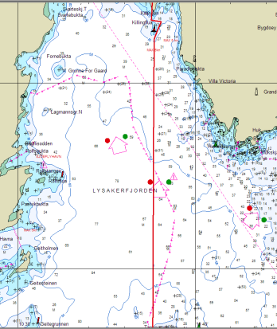
Sea test
Calibration on DL2
Plot a leg on the chart, measure the distance of the leg
Enter the leg into the sea test screen
Sail to the leg at a fixed speed and follow the track. (Not by heading)
When you reach the end of the leg, press stop, turn the vessel
Sail back along the leg at the same speed press start
Press stop when you cross the end point
Feature in latest softwares, ‘stop on GPS’
The Process
B
A
Notes:
Purpose with this slide:
Show ‘Sea test’ calibration
Things to stress:
Sail along the same leg, but not on the vessels wake. ( it is possible to sail on the same course slightly to one side, but be careful it does not get too deep).
There is some debate about whether to sail by heading or course, the important thing is to not adjust too much. The difference is not relevant for a 2% spec.
Linked to exam question:
Background information:
References :

Slide 23
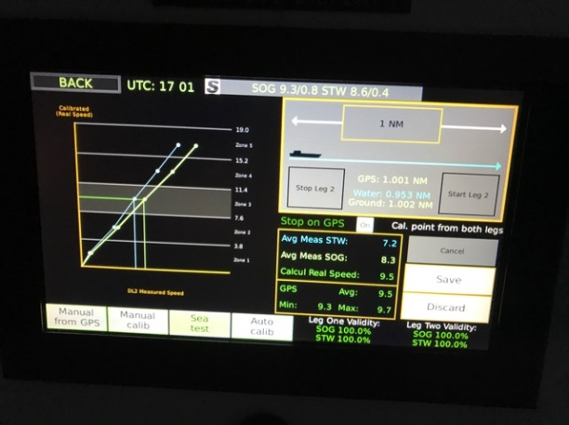
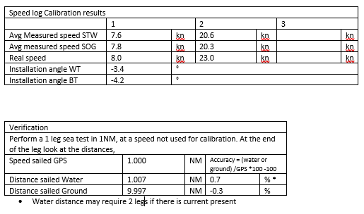
The process of sea test
Calibration on DL2
The table will show the results
Check the GPS avg speed vs the calul real speed, these should be within 0.2 of each other
To check other speeds or to perform accuracy test redo a calibration leg , but do not save the results.
The Process
For a single leg test, it should be sufficient to check the SOG value against the real distance
Notes:
Purpose with this slide:
Status and sea test
Things to stress:
When running a sea test the distance travelled is shown on the right, this can be compared with the chart. 1NM should be logged per leg (of 1 NM)
The data can be quality controlled on the right
Check the speeds are stable, and the SOG and GPS are within about 0.2kn
Check the validity
It is possible to calibrate just STW if the water is too deep
If you have a check list to fill in , fill this in and take a photo of the results screen
Make a run that will take at least 5 minutes, (at 20 kn+ you may need 2NM , at 5kn, only 0.5NM
To do a verification, a single leg is usually ok, but use the Ground and GPS speed, these should be within 2% of each other, some companies allow 5%
If 2 leg verification , then the difference between water ground and GPS are used.
To get less than 1% the conditions need to be very good, calm, low wind
Linked to exam question:
Background information:
References :

Slide 24
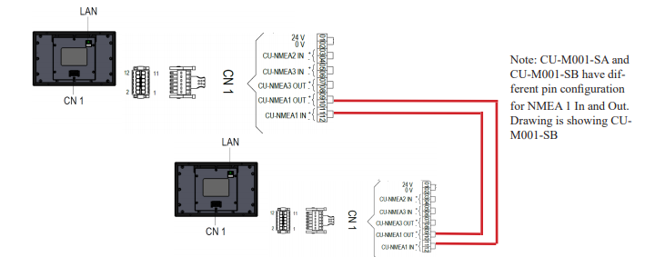
Parallel systems
Calibration on DL2
Many cruise vessels run 2 systems in parallel, it is possible to calibrate both systems at the same legs
Put the 2 lines after each other
The Process
When you reach the end of a line , put the system in standby and start the next system
Using Stop on GPS, the system stops correctly
Turn the vessel and do the same in the opposite direction
System 2
Change system here
System 1
Notes:
Purpose with this slide:
On many cruise ships 2 systems are mounted quite close to eachother.
These can be joined so that when one is put in standby, the other turns on,
This can be used during calibration, set up both systems, and when you reach the end of a leg, swap system, and perform the same leg on the next system.
In this way only 1 turn for both systems
Skipper is working on a system to allow to change speed and do more calibrations in the same leg. (see later)
Things to stress:
Linked to exam question:
Background information:
References :

Slide 25
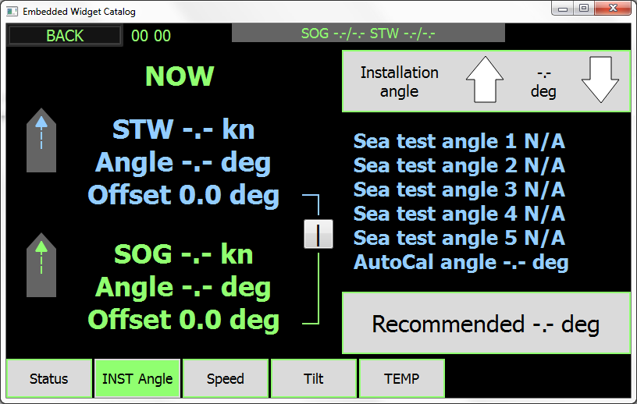
Installation angle
Calibration on DL2
The Sensor may be mounted at a slight angle, this will give a slight error on the Longitudinal and transversal axes, but not on the resultant
This angle is monitored internally and displayed on the installation angle page. If sea tests have been performed each test will have calculated the mounting angle.
The Process
The Speed through water may have a different angle on larger vessels, this will cause the STW to have a slightly sideways offset. This can be set separately.
Notes:
Purpose with this slide:
Calibration of Installation angle
Things to stress:
The sensor may be installed at a slight angle, this rotates all the results.
You may also get a slightly different angle on the STW value than on the SOG value. This is due to water being pressed under the bow at that angle.
This can be separatley compensated for by pressing the ‘|’ in the middle of the page to ‘X’ you can then adjust the parameters separately to give an angle of <0.5 °
Sail in a stable course for at least a minute before adjusting this.
If a sea test has been performed, the table on the right gives expected values for STW.
Linked to exam question:
Background information:
The angle differeence between SOG and STW can vary considerebly , on large oil tankers , values of up to 15 degrees are seen. Generally it has not been seen that this angle changes with speed or depth, but if this is suspected send data with a full range of speedsto skipper. Skipper have tools that can quickly analyse this.
References :

Slide 26
Tilt offset
Calibration on DL2
The system compensates for the tilt of the vessel in pitch and roll
The Sensor contains a MEMS accelerometer that calcultes pitch and roll during each ping
The display of the vessel is reletive to the sensor, if the sensor is tilted slightly in installation, this offset can be changed:
Manually
By trimming the vessel to zero and pressing set
The Process
The tilt information is not approved by current inclinometer standars, and so the information is not given out of the system
Notes:
Purpose with this slide:
Why tilt
Things to stress:
Not important except for on screen values.
There is no NMEA output of this sensor as it does not fulfill the full type standards
Linked to exam question:
Background information:
Previous speed logs have had 3 or 4 beams pointing in differetn directions. This gives both a forward and backward beams and these can be used to compensate for tilt of the vessel. As one beam tils up, the other tilts down.
The DL2 has 2 beams as the space was required for the secondary DL1 system within the same sensor. The titl sensor must therefore be used for compensation of tilt of the vessel.
The tilt is measured throughout each ping and sent to the system. This tilt data is also displayed and the horizontal reference can be adjusted so that it measures the vessel tilt as well as the sensor tilt
References :

Slide 27
Summary
Calibration on DL2
To get to within 2%
Set max speed
Set temp
Perform a sea test on at least max speed
Check the performance by sailing at another speed
This will generally get the system to within 2% accuracy
The Process
Notes:
Purpose with this slide:
Things to stress:
Linked to exam question:
Background information:
References :

Slide 28
Advanced Calibration of the DL2 and DL21 system Part 2
Notes:
Purpose with this slide: Multi introduction
To describe the topics to be spoken about
Things to stress:
Linked to exam question:
Background information:
References :

Slide 29
To get better than 2% accuracy
Calibration on DL2
Better than 1% accuracy is acheived through:
Careful calibration – start and stop when the vessel is
Stable speed
Stable course
Good conditions throughout
Calibration control of both high and low STW tables
Post processing and check the installation angles and speed tables are correct over a range of speeds, and manouvring situations
Setting the averaging to give optimal performance
To understand this it is useful to know how the system processes the data
The Process
Notes:
Purpose with this slide:
The principles of getting a more accurate calibration
Things to stress:
Stable, and careful calibration
Area of stable or no current,
Both legs within a reasonable time, to keep the same conditions of wind and current
Linked to exam question:
Background information:
References :

Slide 30
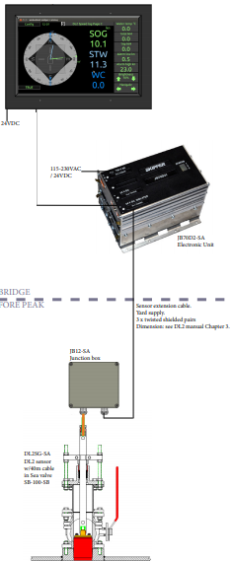
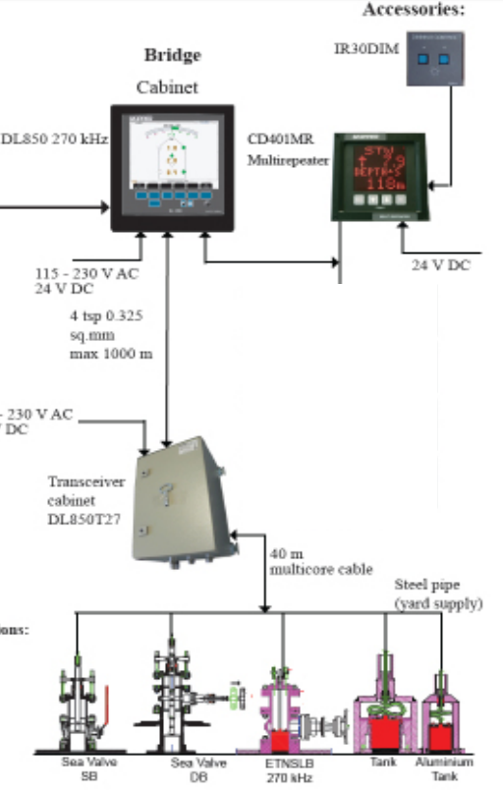
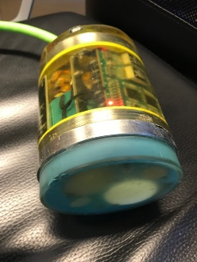
The processing differences between DL850 and DL2
The Transceiver DL850
Analog cable from sensor
Power to bottom of ship
Pulses limited to 1 freq
Multiplexed
3 transducers at 270kHz
The Transceiver DL2
Digital, smaller, in the sensor
2cm cable (very low noise)
Lower power (power down the cable)
2 beams allowing DL21 system in same housing
Multi frequency
The DL2 vs DL850
Why are they different?
Notes:
Purpose with this slide:
To show the dofferences of the 2 DL systems
Things to stress
DL2 is generally lower noise and more accurate due to digital processing, but only has 2 beams
DL850-270 has 3 beams as its only advantage. But this simplifies calibration
Linked to exam question:
Background information:
References :

Slide 31
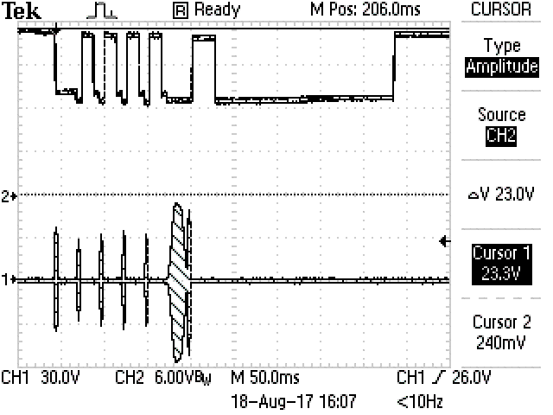
Mulitple frequency
The system measures using 3 frequencies
265 SOG, 265kHz every 600ms
277 STW, every 600ms
850-910 STW high frequency, 4 times every 600ms
Why?
HF is more accurate, but is more sensitive to bubles etc.
HF pings more often and is more accurate
The HF beam is narrower as it uses the same transducers
The partical size in the water varies and at times HF is better than LF
Less interference with SOG values
Backup – a second set of results is available
Coming soon: sensor version 4.00 will ping also low frequency STW pings more often giving more stable LF results.
The DL2 vs DL850
Why are they different?
Notes:
Purpose with this slide:
Why we have frequencies and what they do to the accuracy
Things to stress
Having more frequencies, means more calibrations
Linked to exam question:
Background information:
References :

Slide 32
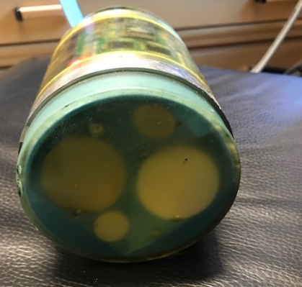
How the differences effect the calibration
Transceiver in Sensor – lower noise more stable signals, more accurate calibration
Multiple frequencies, More calibrating, but done in the system, more to check
2 beams vs 3 beams 2 beams smaller, but needs more calibration ….
The DL2 vs DL850
Why are they different?
Notes:
Purpose with this slide:
To show how the design effects calibration
Things to stress
Although there are a number of calibrations, these are all set automatically, when 1 changes the other changes proportionatly.
If one of them is wrong it is possible to change just that one.
Linked to exam question:
Background information:
References :

Slide 33
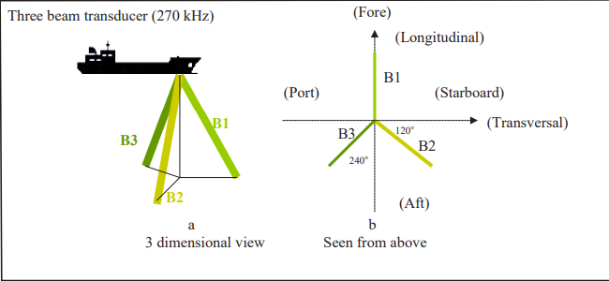
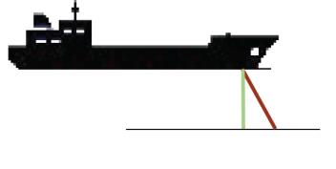
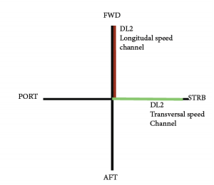
How the differences effect the calibration
2 beams does not allow you to cancel the tilt of the vessel
On average this depends on the tilt of the ship
For each ping we can compensate using the inbuilt tilt sensor
2 beams makes it difficult to remove the vertical water component
The DL2 vs DL850
Why are they different?
Notes:
Purpose with this slide:
Show the differences between DL850 (3 beams) and DL2 (2 beams)
Things to stress
The Beams do not point in the movement direction of the water :With 2 beams, they measure on X and Y axis at 30 degrees from vertical. As the angle changes you get a difference in the speed. If the water crosses the beam at a right angle you do not measure anything, if it travels along the beam you get a large signal. 30 degrees gives a horizontal speed correction factor of about 0.5 . i.e. you measure half the speed. A tilt will have a direct result on the speed. By measuring tilt, you can correct for this per ping and the long term average tilt offset. Generally average wave movement will average out to zero, but not ships tilt offset must be corrected with tilt sensor or calibration. As this changes with ships loading, the tilt sensor is necessary.
Tilt can be averaged out with 3 beam system but not 2, you need a tilt sensor: If you have beams in opposite directions, one will show too much speed, the other too little and it can be averaged out (DL1).
Vertical water can cause issues: If water is not pushed horizontally, but also vertically, then the vertical component will not be measured, and this will effect the angle of the speed. (STW installation angle) This has to be calibrated. As the vertical component may change at different speeds this is measured at each speed. Generally the component is the same at most speeds,
Measure on the same uniform piece of water / current: On a 3 beam system you have an element in all directions, and tilt cancels itself out, but only if you measure on a current that is even. If it is different in the different beams, then you will have an error
Linked to exam question:
Background information:
References :

Slide 34
2 Vs 3 beams theory
Each beam can be written mathematically as
Speed = Ax+By+Cz (where x is along the ship, y is across, z is vertical)
With 2 beams, pointing in direction X and Y you get
Speed alongships = Ax+0y+ Cz
And Speed Acrosships = 0x+By+Cz
If we assume Vertical (z) is zero (over time) then we get speeds.
If we have a third transducer we get a third equation and can work out x, y, and z, and dont have to make an assumption.
If Z does change with speed, then the valance fails, so we have to make a calibration that removes the effects of z at the different speeds
- On large ships the vertical speed of STW is not zero, the water is pressed down typical between 0 and 20 degrees at the bow.
- As the vessel goes faster the vertical component, and some times the direction changes
On a 2 beam system, the STW has to be calibrated more carefully with speed
The DL2 vs DL850
Theory Alert !
Why are they different?
Notes:
Purpose with this slide:
Future calibration
Things to stress
1 beam can measure a value along the beam
2 beams can measure a 2D surface, if you assume the vertical component is zero, then this also works in a 3D environment
3 beams can measure a 3D volume, even a vertical movement
Linked to exam question:
Background information:
References :

Slide 35
How this effect calibration
Larger vessels push more water, this will cause the STW angles to change slightly.
The DL2 allows for additional STW angle correction
The different frequencies have slightly different calibrations
The Low frequency measures generally further from the vessel (2-3m) than the high frequency (0.5-1.5m), The HF has more vertical component.
The HF is slightly more accurate, and samples faster giving a more than 2 x more accurate value than LF
SOG measures on the bottom, this is generally a strong and stable signal. (to 150m)
The result is that STW LF and STW HF have slightly different calibrations
Calibration
Whats new?
Notes:
Purpose with this slide:
Things to stress
Linked to exam question:
Background information:
References :

Slide 36
In Practice?
The DL2 system has a more complicated calibration, but more accurate and stable.
The user sees the STW High frequency unless the signal fails, and then it uses the low frequency
The relative calibration of the STW’s are normally similar, but get adjusted by GPS and Sea test calibrations
The user adjusts 2 Heading angles, one for SOG and one for STW
Calibration
Whats new?
Notes:
Purpose with this slide:
Future calibration
Things to stress
Linked to exam question:
Background information:
References :

Slide 37
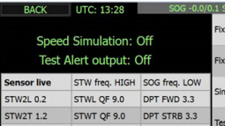
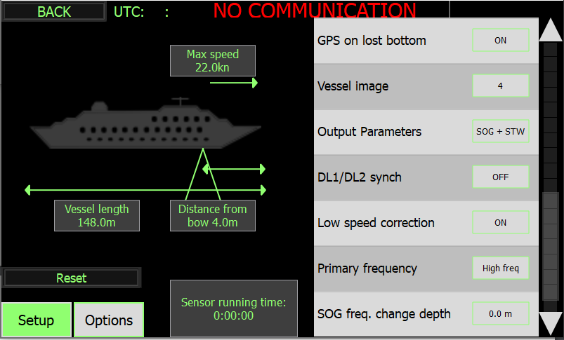
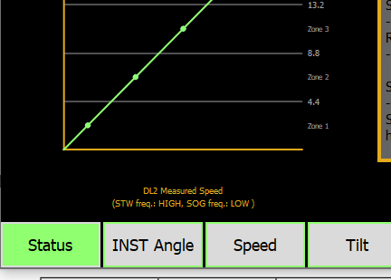
How to check the low frequency STW?
The system is set to prefer a high or low frequency in DL2 config (default High)
While in high frequency (seen on diagnostic or calibration screen) the calibration table is for the high frequency
By changing the prefered frequency to low the Low frequency table will be shown
Calibration
Whats new?
Notes:
Purpose with this slide:
There are 2 speed tables for STW. Hi and Lo frequency
The sea test will calibrate both.
Manual will adjust both proportionatly
It is normally not necessary, but it is possible to adjust the low frequency, by changing the system to measure on low frequency and then check the calibration.
Things to stress
Linked to exam question:
Background information:
References :

Slide 38
Logging data
Inserting a USB stick into the JB70 will do 2 things
Record the current settings and calibrations in a directory called ‘skipper’
Start logging data and serial traffic (30MB files that compress to 2MB , 1 day is about 60MB)
These files can be sent to SKIPPER for analysis and contain raw data from sensor, input data from other systems (GPS GYRO, Echosounder if connected)
If logging data sail for 10 - 30 minute periods at various speeds and skipper can check calibration values.
It is also possible to log via LAN port using service software and IEC-61162-450 UDP Tab.
Post Processing
Tools
Notes:
Purpose with this slide:
Things to stress:
Linked to exam question:
Background information:
References :

Slide 39
Post Processing of Data
Get the files from the USB stick
Unzip, if you only have the .txt and not skipper folder , you will not have the current calibration
SKIPPER directory has the settings and current calibration
Open the software Graphlog
Open the file you wish to view
Select which timeline you wish to see.
Inspect the calibrations
Change values and try again
Post Processing
Tools
Notes:
Purpose with this slide:
Things to stress:
Linked to exam question:
Background information:
References :

Slide 40
Calibration
Intro and the Basics
One off, non expected results seen from logs:
Calibration or Physical laws?
Currents
Differences between high and low frequency (measuring point) – Layers of current
Currents from rivers
‘Jet streams’ as the vessel turns water is funnelled
Wakes
Bubble layers or local movement from pipe outlets movement ( can hang for up to 30 minutes
Squat effect (faster moving water under the vessel
Notes:
Purpose with this slide: Diagnostics menu
What factors influence the accuracy of a speed log? And how can we remove them.
The difficult part to measure is STW, SOG is much more stable
The most important factor is the flow of water around the sensor
Each hull is different, the position of the sensor can make a lot of difference
The angle of the sensor
The flow of water is different near the hull and further away, where does the sensor measure, this changes over time with the growth on the hull
The EML measures very close, The Doppler can measure very close at high frequencies or further out with lower frequencies
Things to stress:
Angle of sensor
Angle of the water flowing past
The stability of the water flowing past
Growth
Squat effect is an interesting example where shallow water causes a suction (low pressure) under the vessel this can lead to
Jet streams of water, moving much faster.
Linked to exam question:
Background information:
References :

Slide 41
Whats next in calibration?
Calibration is currently too complicated!
Simple until it goes wrong
SKIPPER is working on new functions to simplify and automate calibration.
Calibration over time using the GPS and Gyro as a reference
Calibration posibility in 1 direction only (just a shift of course)
Continuous control of the calibration relative to GPS, SOG, STW - to keep it always within 0-2% accuracy
Notes:
Purpose with this slide:
Future calibration
Things to stress
The hope is that in early 2021 we will release a version with an auto calibration. This will save data of the system over time and recalculate the calibration. This works on the principle of average current being near zero.
And will help compensate for other potential long term errors in the system. For this to work the system should be installed with Heading and GPS.
Linked to exam question:
Background information:
References :

Slide 42
Whats next in calibration?
Calibration is currently too complicated
A sensor firmware is now under test (4.00) that pings on both high and low frequency 5 times a second. Giving 2 STW solutions that are both high accuracy. From this, STW becomes more robust and accurate
A routine to perform up to 5 speed calibrations with just 1 turn (Graphic EML) and also to help the calibrator to start at the correct stability of speed and course.
These improvments are expected by end of 2020
Notes:
Purpose with this slide:
Future calibration
Things to stress
The hope is that in early 2021 we will release a version with an auto calibration. This will save data of the system over time and recalculate the calibration. This works on the principle of average current being near zero.
And will help compensate for other potential long term errors in the system. For this to work the system should be installed with Heading and GPS.
Linked to exam question:
Background information:
References :

